Slide 1
So how do you score this answer?

Slide 3
Natural Classroom Assessment

Slide 4
Good Things:

Slide 5
Goals:
Why is Assessment a topic for the Teacher Leaders group?
What are the various types of Assessment?
Review book – Natural Classroom Assessment
Overview of District Assessment Tools
Discussion of how the various levels utilize assessments.
Assessment Discussion and Launch

Slide 6
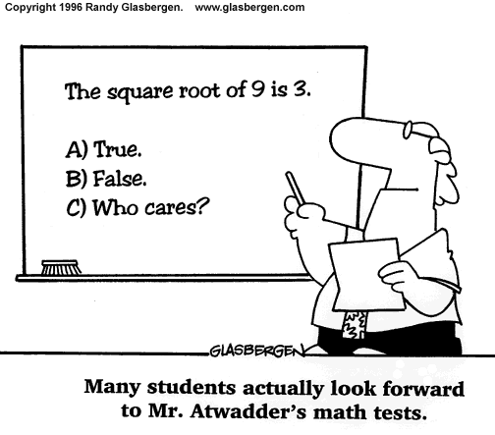

Slide 7
What do Assessments have to do with Leadership?

Slide 9
?
?
?
?

Slide 10
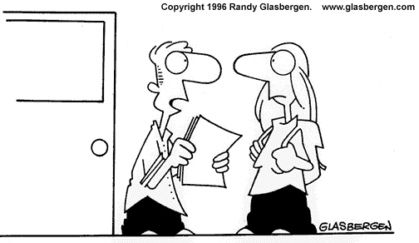
I used a $3,000 computer, a $1,200 printer, and $200 word processing program, and I still got a “D” on my norm-referenced testing project report in Mr. Thomas’ class.

Slide 11
Book Processing
Work in groups of 2-3
Key points in chapter
Summarize Chapter in one sentence
Share with whole group

Slide 12
Application:
On the cartoon given your group, explain how it relates to the material in the book, Natural Classroom Assessment.

Slide 14
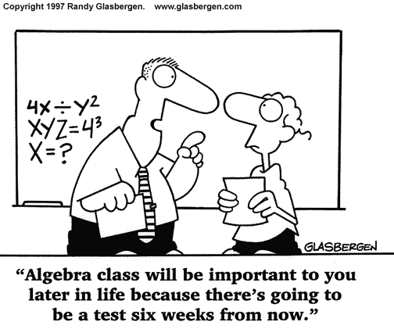

Slide 15
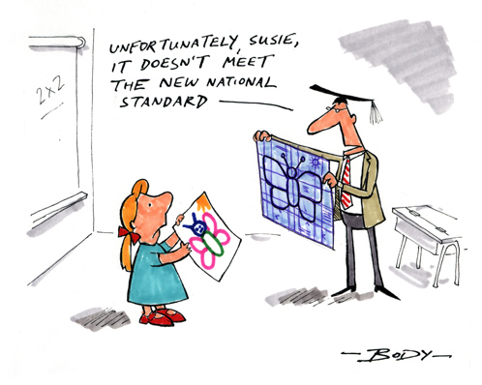

Slide 16
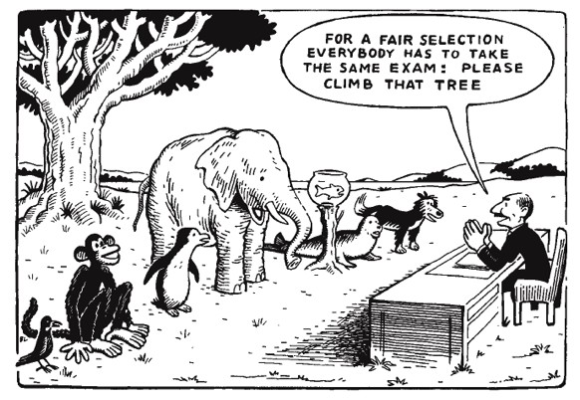

Slide 17
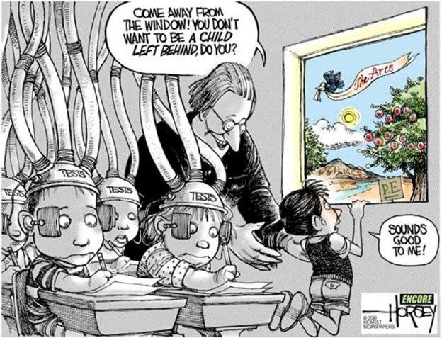

Slide 20
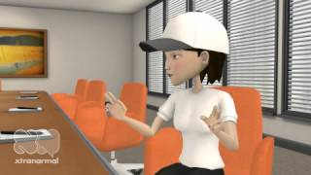
“I Choose C”
http://www.youtube.com/watch?feature=player_detailpage&v=dY2mRM4i6tY

Slide 21
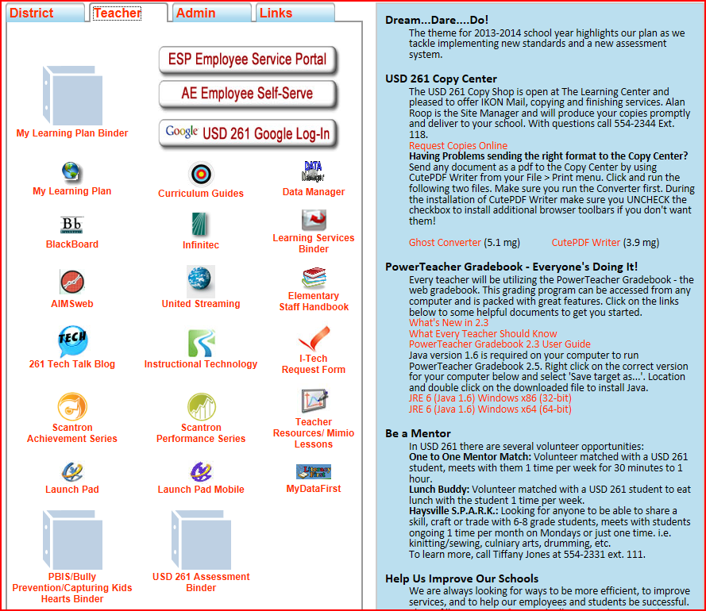
District Assessment Plan
http://www.usd261.com/Staff/index.htm

Slide 22
Grade Level Discussion Items:
What assessments do you give at your level?
What is the purpose for the assessments?
How do you share the student data?
What suggestions do you have related to assessments?

Slide 24
Launch!

Slide 26
